Slide 1
Validation and Fault Processing
Service-Oriented Software Engineering
Software Institute
Nanjing University
Bei Jia

Slide 2
Validation and Fault Processing
Validation and fault processing are critical components of implementing a Web service that are often overlooked
  Validation is critical because it is much more efficient to reject an XML message as invalid based on its structure than to allow an unpredictable failure to occur during the business logic processing of the bad data
  Fault processing is important because any exception thrown by your Java code needs to potentially get translated into a SOAP fault that can be sent back to the client informing him of why the Web service invocation failed

Slide 3
Validation
When you develop a service implementation bean starting with a WSDL document, one of the things you often want to do is validate the incoming SOAP message against your WSDL types to make sure it is valid
When you are using JAXB outside of JAX-WS, you can turn on validation by using the setSchema() methods provided by Marshaller and Unmarshaller. You simply pass in the schema, as an instance of javax.xml.validation.Schema, and JAXB validates against it during marshalling or unmarshalling
Unfortunately, in JAX-WS 2.0, you don’t have the ability to turn on JAXB validation like that. So, you have to roll your own

Slide 4
Validation in RequestOrderEndpoint.java (1/3)
WebServiceContext is injected by @Resource annotation
…
if ( webServiceContext == null ) {
throw new RuntimeException("WebServiceContext not injected.");
}
MessageContext mc = webServiceContext.getMessageContext();
ServletContext sc = (ServletContext) mc.get(MessageContext.SERVLET_CONTEXT);
if ( sc == null ) {
throw new RuntimeException("ServletContext is null.");
}
InputStream wsdlStream =
sc.getResourceAsStream("/WEB-INF/wsdl/RequestOrder.wsdl");
if ( wsdlStream == null ) {
throw new IOException("WSDL resource not found.");
}
…
ServletContext contains WSDL

Slide 5
Validation in RequestOrderEndpoint.java (2/3)
…
DocumentBuilderFactory dbfac = DocumentBuilderFactory.newInstance();
DocumentBuilder docBuilder = dbfac.newDocumentBuilder();
Document wsdlDoc = docBuilder.newDocument();
Transformer xformer = TransformerFactory.newInstance().newTransformer();
xformer.transform(new StreamSource(wsdlStream), new DOMResult(wsdlDoc));
NodeList schemaNodes = wsdlDoc.getElementsByTagNameNS(
XMLConstants.W3C_XML_SCHEMA_NS_URI, "schema");
int numOfSchemas = schemaNodes.getLength();
Source[] schemas = new Source[numOfSchemas];
Document schemaDoc;
Element schemaElt;
for (int i=0; i < numOfSchemas; i++) {
schemaDoc = docBuilder.newDocument();
NamedNodeMap nsDecls = getNamespaces((Element) schemaNodes.item(i));
schemaElt = (Element) schemaDoc.importNode(schemaNodes.item(i), true);
for (int j=0; j<nsDecls.getLength(); j++) {
Attr a = (Attr) schemaDoc.importNode(nsDecls.item(j), true);
schemaElt.setAttributeNodeNS(a);
}
schemaDoc.appendChild(schemaElt);
schemas[i] = new DOMSource(schemaDoc);
}
…
Extract the XML schemas from WSDL’s <types> section

Slide 6
Validation RequestOrderEndpoint.java (3/3)
…
SchemaFactory schemaFac = SchemaFactory.
newInstance(XMLConstants.W3C_XML_SCHEMA_NS_URI);
Schema schema = schemaFac.newSchema(schemas);
Validator validator = schema.newValidator();
if (!DOMSource.class.isInstance(payload) &&
!SAXSource.class.isInstance(payload) ) {
Document payloadDoc = docBuilder.newDocument();
xformer.transform(payload, new DOMResult(payloadDoc));
payload = new DOMSource(payloadDoc);
}
try {
validator.validate(payload);
} catch (SAXException se)
{…

Slide 7
Fault Processing
The WSDL specification provides a tag—wsdl:fault—for specifying fault messages.
Ideally, all SOAP faults emitted by a Web service would conform to one of the WSDL’s wsdl:fault message formats. Unfortunately, that is not necessarily the case
  Many WSDL interface definitions do not even include wsdl:fault declarations, and just emit a SOAP fault of unspecified type when something goes wrong
So, some Java exceptions that can reasonably be mapped to a wsdl:fault message (mapped exceptions). But some Java exceptions have to be represented as generic SOAP faults (unmapped exceptions)

Slide 8
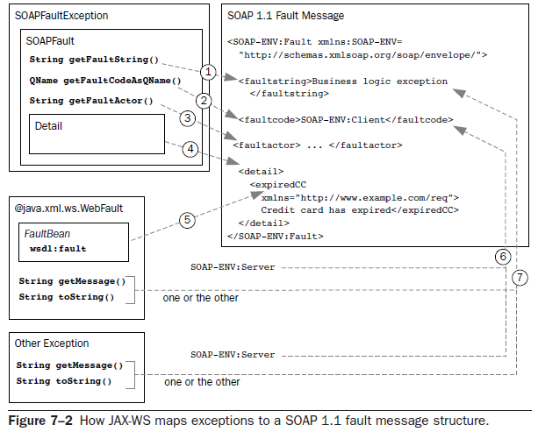
Mapping between Exception and SOAP fault
Unmapped
Mapped

Slide 9
Mapping between Mapped Exception and SOAP fault
@WebFault annotates a mapped exception. The fault bean wrapped by the mapped exception corresponds to the detail element of the SOAP fault message
The faultcode corresponding to a mapped exception is always SOAP-ENV:Server
  This can be misleading, especially when the fault was generated by a poorly constructed SOAP request
The faultstring corresponding to a mapped exception is mapped from the getMessage()method, unless that returns null, in which case it is mapped from toString()

Slide 10
Mapping between Unmapped Exception and SOAP fault
A SOAPFaultException wraps a javax.xml.soap.SOAPFault that has a straightforward mapping to a SOAP 1.1 fault message.
  The getFaultString method maps to the faultstring element
  The getFaultCodeAsQName method maps to the faultcode
  The getFaultActor method maps to the faultactor element
  The SOAPFault class references an instance of javax.xml.soap.Detail, which represents the detail element of a SOAP fault message. A Detail object is a container for javax.xml.soap.DetailEntry instances—each of which maps to a child element of the SOAP fault’s detail element
Other exceptions (besides SOAPFaultExceptions and @WebFault mapped exceptions) are also transformed by JAX-WS into SOAP fault messages
  In the case of a general exception, the faultcode also gets the default value of SOAP-ENV:Server
  The faultstring corresponding to a general exception is mapped from the getMessage() method, unless that returns null, in which case it is mapped from toString()

Slide 11
Mapped exceptions
The JAX-WS WSDL to Java mapping binds wsdl:fault messages to generate subclasses of java.lang.Exception. When you generate a SEI from a WSDL, these mapped exception classes are also generated
  For example, When an exception is thrown because input message validation fails, this would be a mapped exception because the WSDL writer could anticipate such an exception and define a wsdl:fault message for it
So, if you have implemented your Web service using a SEI mapped from a wsdl:portType, one option for returning a SOAP fault is to throw a mapped exception, which the JAX-WS runtime will automatically translate into the appropriate wsdl:fault message, wrap in the SOAP body, and return

Slide 12
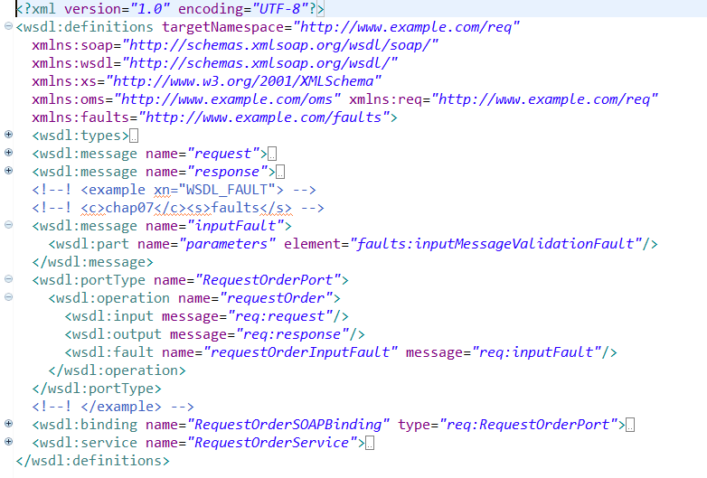
Mapped exceptions RequestOrder.wsdl
The global element declaration is mapped to a JavaBean called a fault bean

Slide 13
Mapped exceptions RequestOrder.java
…
public OrderType requestOrder(String custNum, String poNum, BUSOBJCCARD ccard, List<BUSOBJITEM> itemList) throws InputFault {
InputMessageValidationFaultType ft = new InputMessageValidationFaultType();
if ( custNum == null ) {
ft.setMsg("Customer Number cannot be null.");
throw new InputFault("Input parameter failed validation.", ft);
}
if ( poNum == null && ccard == null ) {
ft.setMsg("Must supply either a PO or a CCard.");
throw new InputFault("Input parameter failed validation.", ft);
}
if ( itemList == null || itemList.isEmpty() ) {
ft.setMsg("Must have a least one item.");
throw new InputFault("Input parameter failed validation.", ft);
}
…
Mapped from the XML schema referenced by the wsdl:fault message
Mapped from the wsdl:message corresponding to this wsdl:fault itself. The name is inputFault and, hence, JAX-WS has generated a mapped exception named InputFault

Slide 14
Mapped exceptions InputFault.java
…
@WebFault(name = "inputMessageValidationFault",
targetNamespace = "http://www.example.com/faults")
public class InputFault
extends Exception {
private InputMessageValidationFaultType faultInfo;
public InputFault(String message, InputMessageValidationFaultType faultInfo) {
super(message);
this.faultInfo = faultInfo;
}
…
Identifies this class as a mapped exception
It is really a simple wrapper for this fault bean

Slide 15
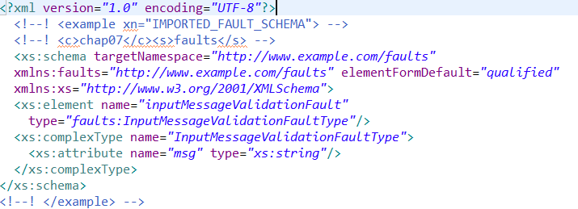
Mapped exceptions faults.xsd

Slide 16
Mapped exceptions InputMessageValidationFaultType.java
…
@XmlAccessorType(AccessType.FIELD)
@XmlType(name = "InputMessageValidationFaultType")
public class InputMessageValidationFaultType {
@XmlAttribute
protected String msg;
public String getMsg() {
return msg;
}
public void setMsg(String value) {
this.msg = value;
}
}
…

Slide 17
Unmapped Exception SOAPFaultException in RequestOrderEndpoint.java
If you are not working with a SEI and don’t have any mapped exceptions to take advantage of, and if you are working with a SEI but you have to handle an exception that doesn’t correspond to a wsdl:fault, you can construct and throw an instance of the SAAJ class javax.xml.ws.soap.SOAPFaultException
The JAX-WS runtime converts it to a SOAP fault message and returns it to the client
…
String errorMsg = validateAgainstWSDL(payload);
if ( errorMsg != null ) {
SOAPFactory fac = SOAPFactory.newInstance();
SOAPFault sf = fac.createFault(
"SOAP payload is invalid with respect to WSDL.",
new QName("http://schemas.xmlsoap.org/soap/envelope/", "Client"));
Detail d = sf.addDetail();
SOAPElement de = d.addChildElement(new QName(
"http://www.example.com/faults", "inputMessageValidationFault"));
de.addAttribute(new QName("", "msg"), errorMsg.replaceAll("\"",""));
throw new SOAPFaultException(sf);
}…

Slide 18
Unmapped Exception WebServiceException in RequestOrderEndpoint.java
When logical fault not defined in WSDL, we throw a general javax.xml.ws.WebServiceException—the base exception class for all JAX-WS run-time exceptions
…
Element expireDateElt = (Element) ccardElt.getElementsByTagNameNS(
OMS_NS, "CC_EXPIRE_DATE").item(0);
String expireDateStr =
((Text) expireDateElt.getFirstChild()).getNodeValue();
String today = dateAsString(new GregorianCalendar());
if (expireDateStr.compareTo(today) < 0 ) {
throw new WebServiceException("Expired ccard.");
}
…

Slide 19
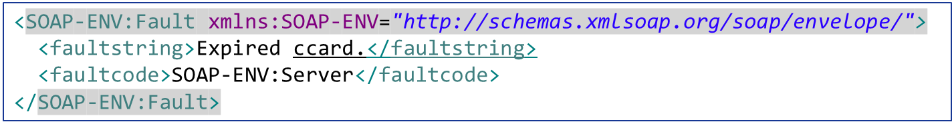
A SOAP fault message creates from WebServiceException
soapfault_from_webserviceexception.xml
By default
No detail

Slide 20
Define faultcode with SOAPFaultException RequestOrder.java
If we want to produce a more accurate SOAP fault message, SOAPFaultException will be used
…
if ( hasExpired(ccard) ) {
try {
SOAPFactory fac = SOAPFactory.newInstance();
SOAPFault sf = fac.createFault("Business logic exception",
new QName("http://schemas.xmlsoap.org/soap/envelope/", "Client"));
Detail d = sf.addDetail();
DetailEntry de = d.addDetailEntry(
new QName("", "expiredCC"));
de.setValue("Credit card has expired");
throw new SOAPFaultException(sf);
} catch (SOAPException e) {
throw new RuntimeException(
"Failed to create SOAPFault: " + e.getMessage());
}
…

Slide 21
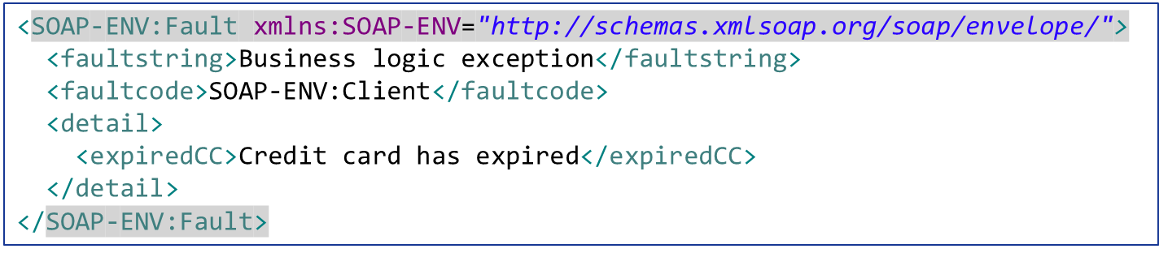
Define faultcode with SOAPFaultException soapfault_from_soapfaultexception.xml

